Slide 1
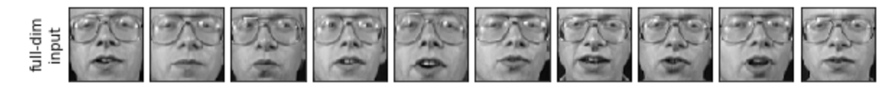
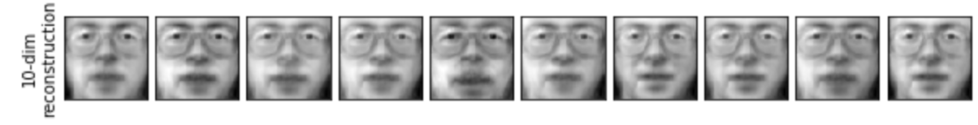
Faces dataset
Processing
PCA
(explained variance)
Pipeline 1
Pipeline 2
Pipeline 3
Pipeline 4
Pipeline 5
Pipeline 6
XGB
+
PCA(5)
XGB
+
PCA(10)
XGB
+
PCA(50)
XGB
+
PCA(100)
XGB
+
PCA(250)
XGB
+
PCA(280)
Evaluate
Evaluate
Evaluate
Evaluate
Evaluate
Evaluate
Filter
XGB
+
PCA(10)
benchmark
Inversion

Slide 2
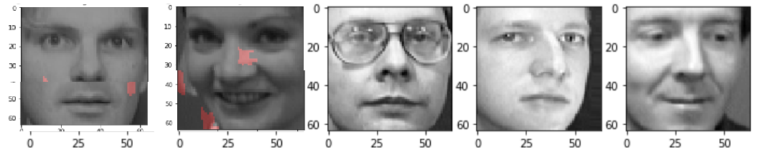
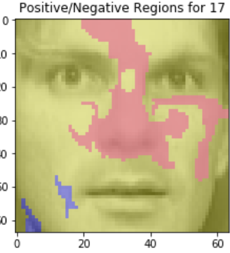
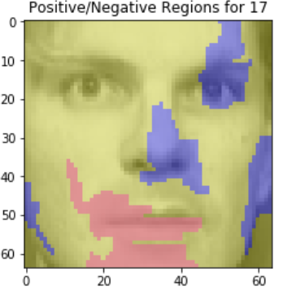
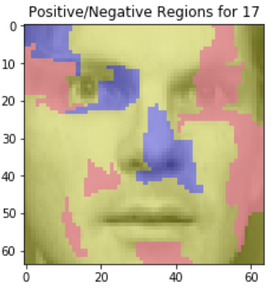
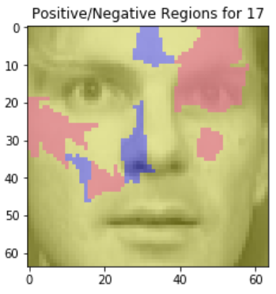
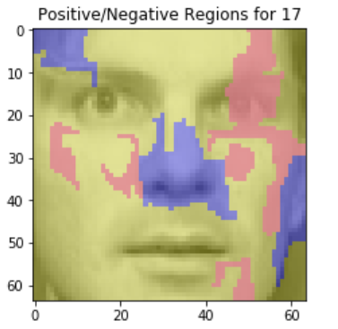
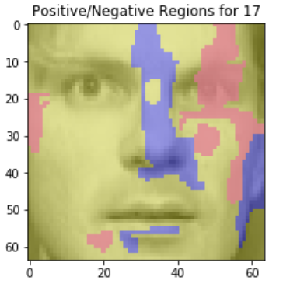
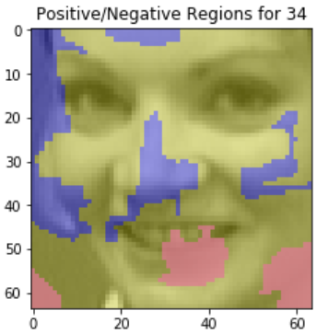
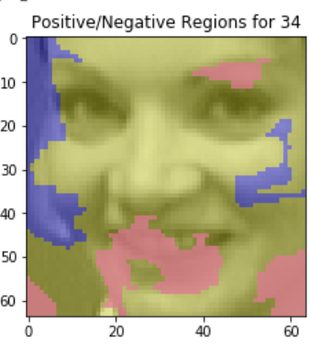
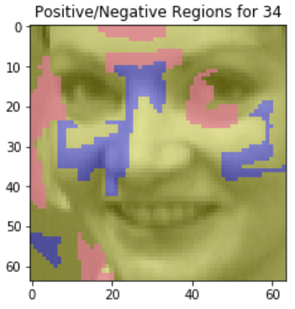
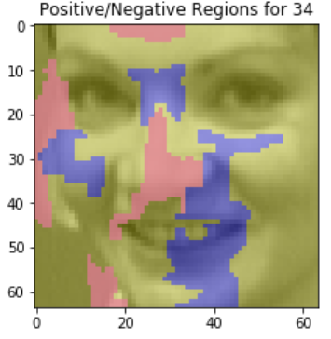
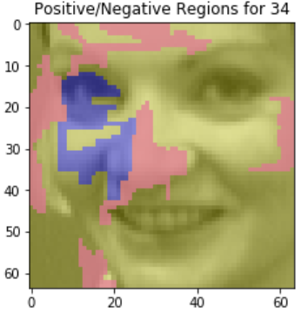
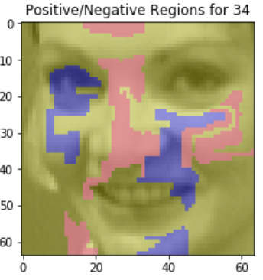
Get Wrong predictions shared by non-benchmark models
Interpret Pipeline 1
Interpret Pipeline 2
Interpret
Pipeline 3
Interpret
Pipeline 4
Interpret
Pipeline 5
Interpret
Pipeline 6
XGB
+
PCA(5)
XGB
+
PCA(10)
XGB
+
PCA(50)
XGB
+
PCA(100)
XGB
+
PCA(250)
XGB
+
PCA(280)
Compare with Benchmark for interpretability

Slide 3
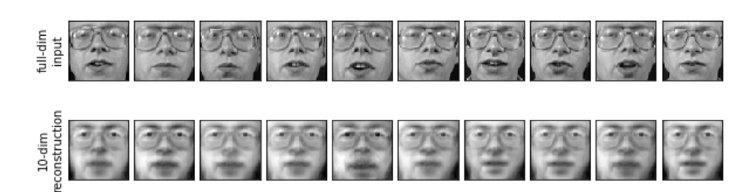

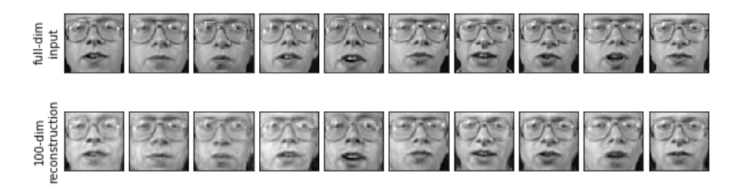

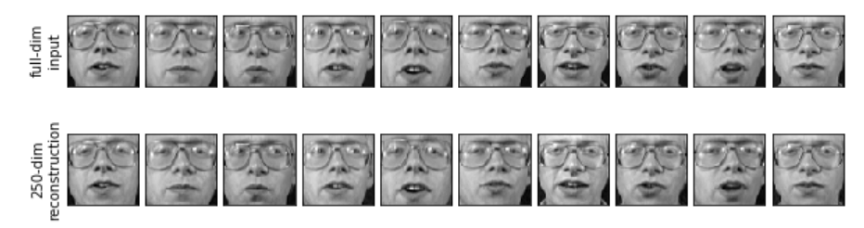

inversion
Precision + XGB
Variance
Highest precision
Lower variance
PCA(10)
Looks blurred
0.7
PCA(100)
Better
0.9
Best!
0.95
PCA(250)

